Slide 1
Data Mining
Ch 8/9: Classification
Backpropagation Algorithm Example
Wan D. Bae, Ph.D.
baewd@hanyang.ac.kr

Slide 2
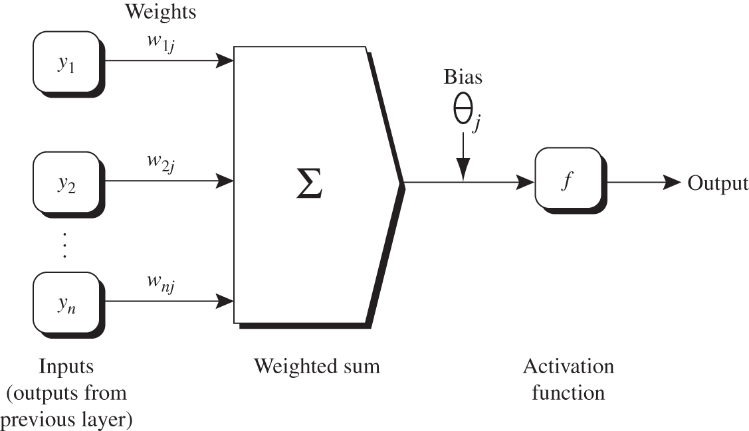
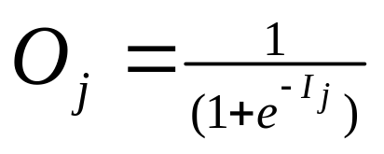
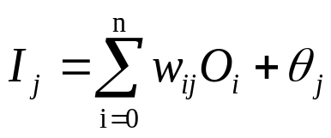
Hidden or output layer unit j
Hidden or output layer unit j
Logistic function or sigmoid function
Net input
A nonlinear activation function is applied to the net input
  If unit j were in the first hidden layer, then these inputs would correspond to the input tuple (x₁, x₂, … , x_{n}).)

Slide 3

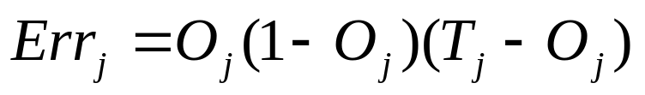

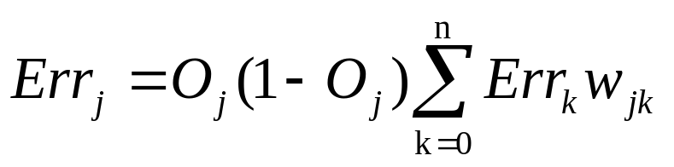


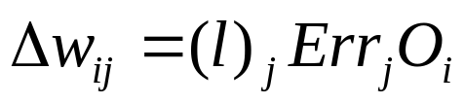
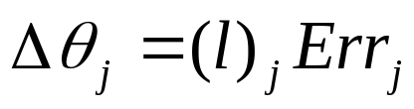
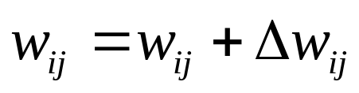
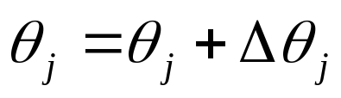

Backpropagate the Error
For a unit j in the output layer, the error is computed by
: the known target value of the given training tuple
: the derivative of the logistic function
For a unit j in the hidden layer, the error is computed by
: the error of unit k in the next higher layer
: the weight of from unit j to a unit k
The weights and biases are updated to reflect the propagated errors
The learning rate : a constant between 0 and 1, set to 1/t,
where t is the number of iterations through the training set so far

Slide 4
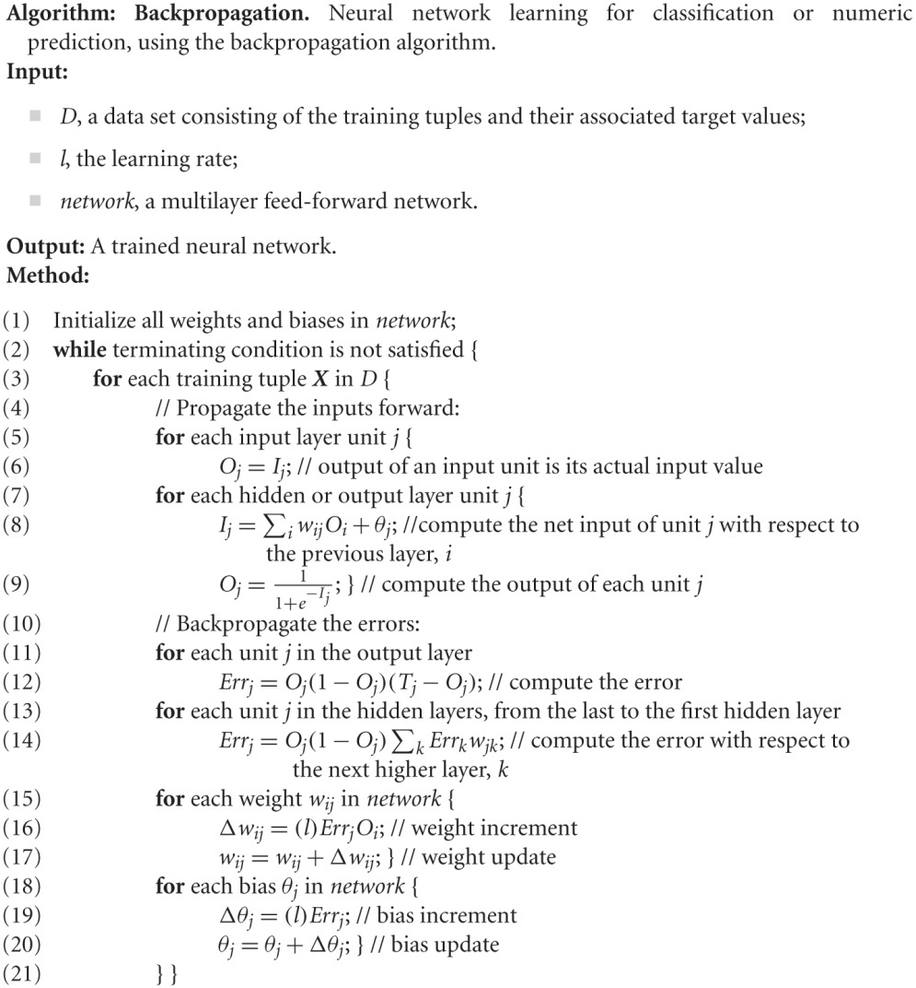

Slide 5
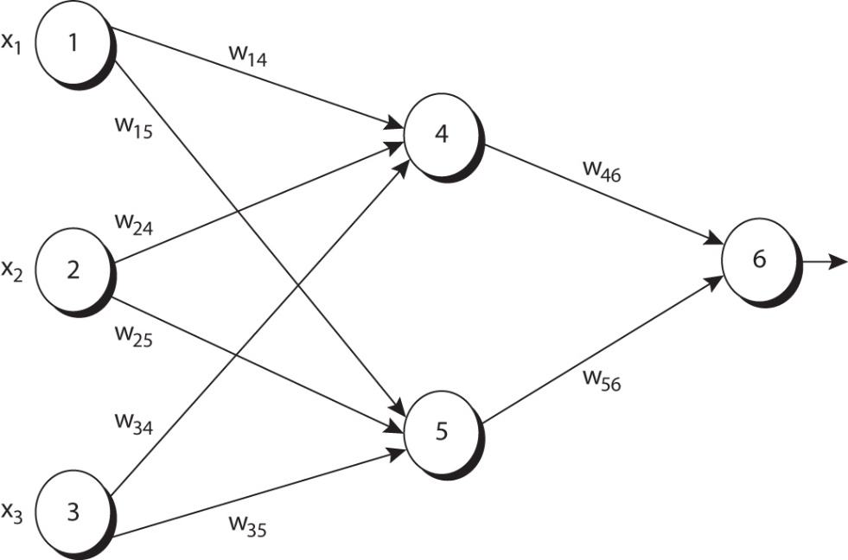
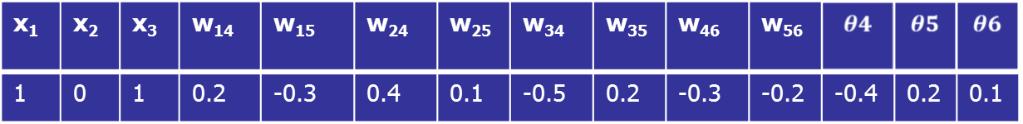
Sample Calculation for Learning
The first training tuple X = (1, 0, 1), with a class label of 1

Slide 6

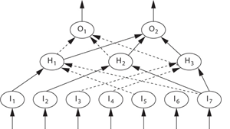



Extract Rules from Training Neural Networks

